Slide 1

Team BeastWatch Himanshu, Avi, Taskeen, Bina, Satvik, Mihir
Team BeastWatch Himanshu, Avi, Taskeen, Bina, Satvik, Mihir

Slide 2
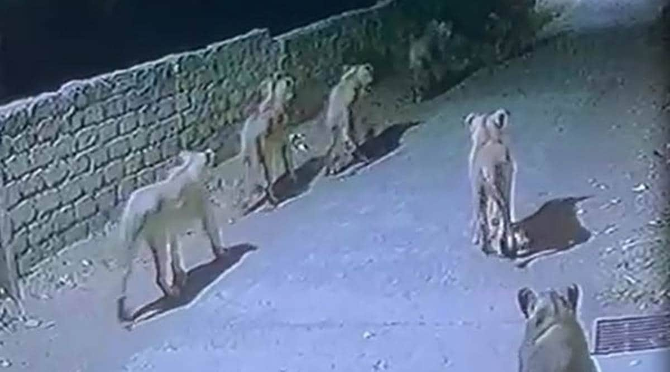
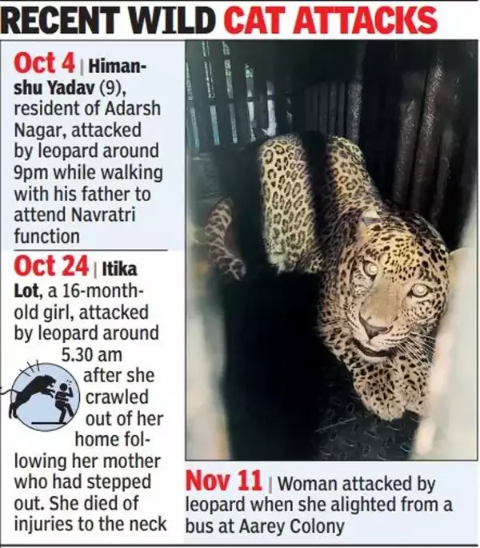
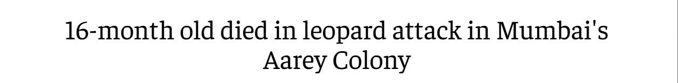
Problem Statement
Many villages and cities Worldwide face frequent wild animal intrusions.
These incidents result in loss of livestock, property damage, and human casualties.
Lack of an efficient early warning system leaves communities vulnerable.
Goal: Notify villagers immediately when a dangerous animal enters the area.
Team BeastWatch Himanshu, Avi, Taskeen, Bina, Satvik, Mihir

Slide 3
Solution BeastWatch
BEASTWATCH uses AI-powered Computer Vision and VLM (Vision-Language Models).
Detects wild animals in real-time using surveillance cameras.
Sends instant alerts to warn villagers and authorities.
Differentiates between real threats and false triggers to reduce panic.
Team BeastWatch Himanshu, Avi, Taskeen, Bina, Satvik, Mihir

Slide 4
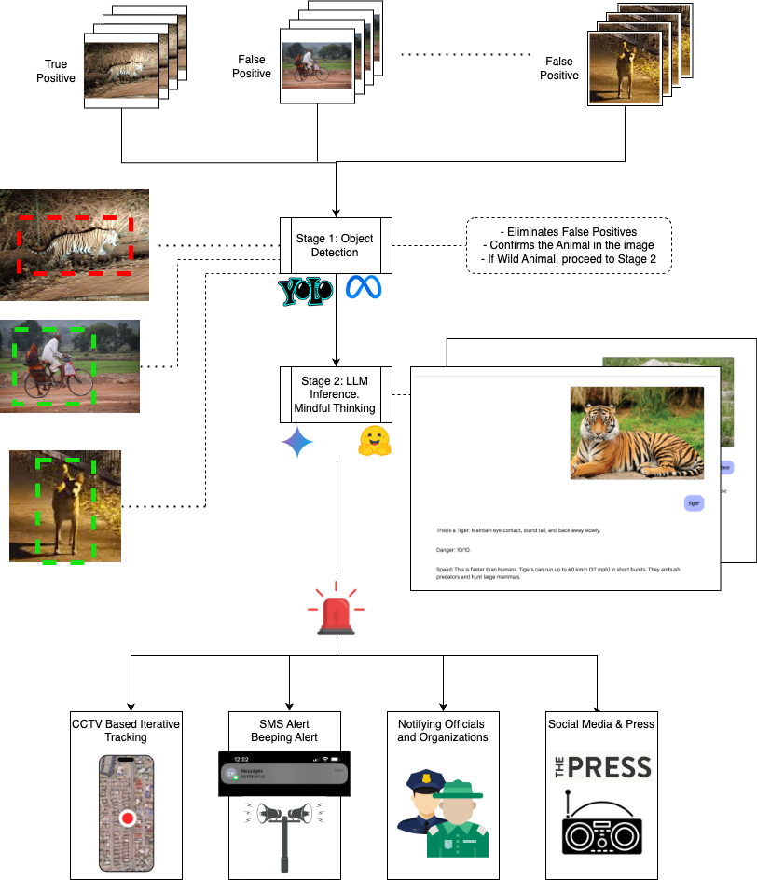
Workflow
Team BeastWatch Himanshu, Avi, Taskeen, Bina, Satvik, Mihir

Slide 5
Potential Challenges
False Alarms: Reducing errors in detection.
Uninterrupted Electricity
Infrastructure Limitations: Availability of cameras in remote areas.
Real-Time Processing: Ensuring fast and reliable alerts.
Community Adoption: Encouraging locals to use and trust the system.
Team BeastWatch Himanshu, Avi, Taskeen, Bina, Satvik, Mihir

Slide 6
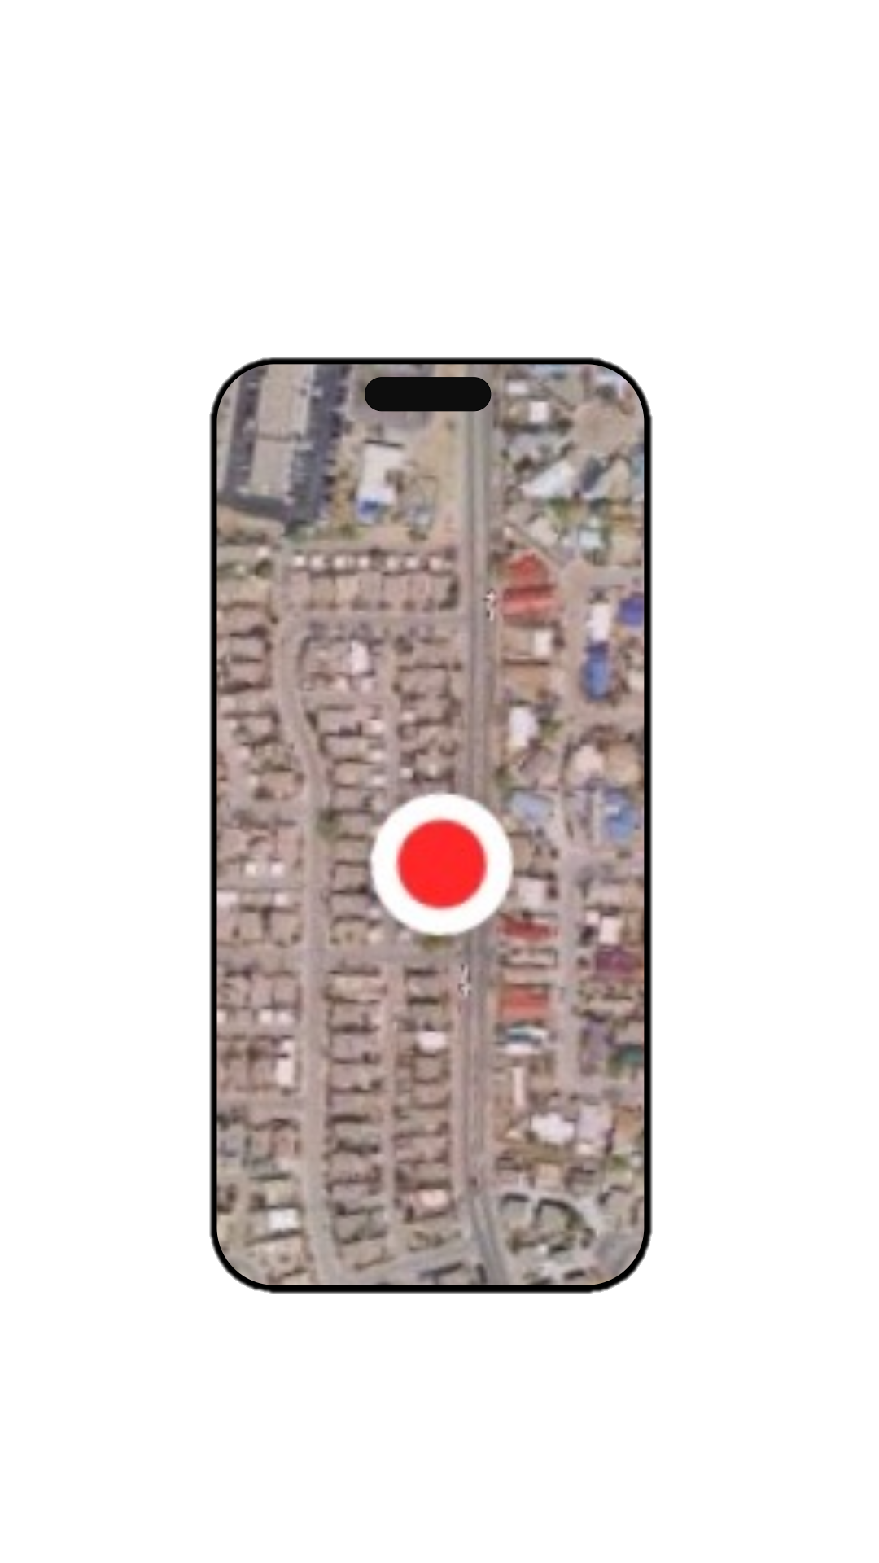
Future Improvements
AI model for better accuracy and fewer false alerts.
Expand to more regions with varied landscapes and species.
Integrate predictive analytics for animal movement patterns.
Collaborate with wildlife conservation authorities for tracking and data sharing.
Team BeastWatch Himanshu, Avi, Taskeen, Bina, Satvik, Mihir

Slide 7
Citations
Jocher, G., Qiu, J., & Chaurasia, A. (2023). Ultralytics YOLO (Version 8.0.0) [Software]. Ultralytics. Retrieved from https://ultralytics.com
Jana, Antoreep. "Animals Detection Images Dataset." Kaggle, 2022, www.kaggle.com/datasets/antoreepjana/animals-detection-images-dataset.
Team BeastWatch Himanshu, Avi, Taskeen, Bina, Satvik, Mihir

